Slide 1
Practical's Syntax and Example
Day 1 to 6

Slide 2
Create Table
Syntax:-
CREATE TABLE table_name(
Column_name 1 Datatype(Size),
Column_name 2 Datatype(Size),
Column_name N Datatype(Size) );
Example:-
Create Table Student(
Rollno number(2),
Name Varchar2(10) );

Slide 3
Create table Primary key and Foreign key
Syntax:-
CREATE TABLE Table _name(
Column_Name DataType (Size)Primary key,
Column_Name DataType(Size) References Table_Name(Column_name) );
Example:-
Create Table Teacher(
T_id Number(3) Primary key,
T_Name varchar2(10),
Roll_no number(2) References Student(Rollno) );

Slide 4
Insert values in Table
Syntax:-
INSERT INTO Table_name VALUES(Col1, Col2,………Col3);
Example:-
Insert into Student Values(&Rollno,’&name’);
Insert into Student Value(1,’Xyz’);

Slide 5
Display All Records of Tables
Syntax:-
SELECT * FROM Table_name;
Example:-
Select * from Student;
Select Rollno from Student;
Select Rollno,Name from Student;

Slide 6
Display Only Structure Of table
Syntax:-
DESC Table_Name;
Example:-
Desc Student;

Slide 7
Where Clause
Syntax:-
Select * from table_name WHERE Column_name = Value;
Example:-
Select * from Student WHERE Rollno =5;
Select Name from Student WHERE Name LIKE ‘A%’ AND Name Like ‘B%’;
Condition 1
Condition 1 Condition 2

Slide 8
Create Table from another Table
Syntax:
CREATE TABLE New_Table_Name AS SELECT * FROM Old_Table_Name;
Example:
create table client as select * from client_master;

Slide 9
Insert Records from another Table
Syntax:-
INSERT INTO NEW_TABLE_NAME SELECT * FROM OLD_TABLE_NAME;
Example:-
insert into client select * from client_master;

Slide 10
Delete Records from Table
Syntax:-
DELETE FROM Table_Name WHERE Column_name= ‘Value’;
Example:-
Delete from student WHERE Rollno =1;
Delete from Student WHERE Name =‘xyz’ AND Name =‘pqr’;

Slide 11
Update table Records
Syntax:-
UPDATE TABLE_NAME SET Column_Name =‘ New value’ WHERE Column_Name= ‘Old_ value’;
Example:-
Update Student SET Name =‘jenny’ WHERE Name =‘xyz’;
Update EMP SET salary = 50000 WHERE salary > 20000;

Slide 12
Destroying Table
Syntax:-
TRUNCATE TABLE Table_name;
DROP TABLE Table_name;
Example:-
Truncate Table Emp;
Drop Table student;
Truncate not Destroy structure of table but Drop Destroy Structure of Tablel.

Slide 13
Modifying Structure
Add Column
Syntax:-
ALTER TABLE Table_name ADD New_Column_Name DataType(Size);
Example:-
Alter Table Student ADD Marks number(2);
Drop Column
Syntax:-
ALTER TABLE Table_Name DROP COLUMN Column_Name;
Example:-
ALTER Table Emp DROP COLUMN Adresss1;

Slide 14
Modifying Structure
Modifying Existing Column
Syntax:-
ALTER TABLE Table_name MODIFY Column_name DataType(Size);
Example:-
Alter table Student Modify Rollno number(3);
Rename Existing Column
Syntax:-
ALTER TABLE Table_Name RENAME COLUMN Old_column_name TO New_Column_name;
Example:-
Alter Table Student RENAME COLUMN Rollno TO Rno;

Slide 15
Rename Table
Syntax:-
RENAME Old_Table_Name TO New_Table_Name;
Example:-
Rename Student TO Student_Master;

Slide 16
Order By
.
The ORDER BY clause in SQL is used to sort the result set in ascending or descending order.
Syntax:-
SELECT column1, column2, ...
FROM table
ORDER BY columnA, columnB, ...;
Example:-
- orders all rows from Customers in ascending order by country
SELECT *
FROM Customers
ORDER BY country;

Slide 17
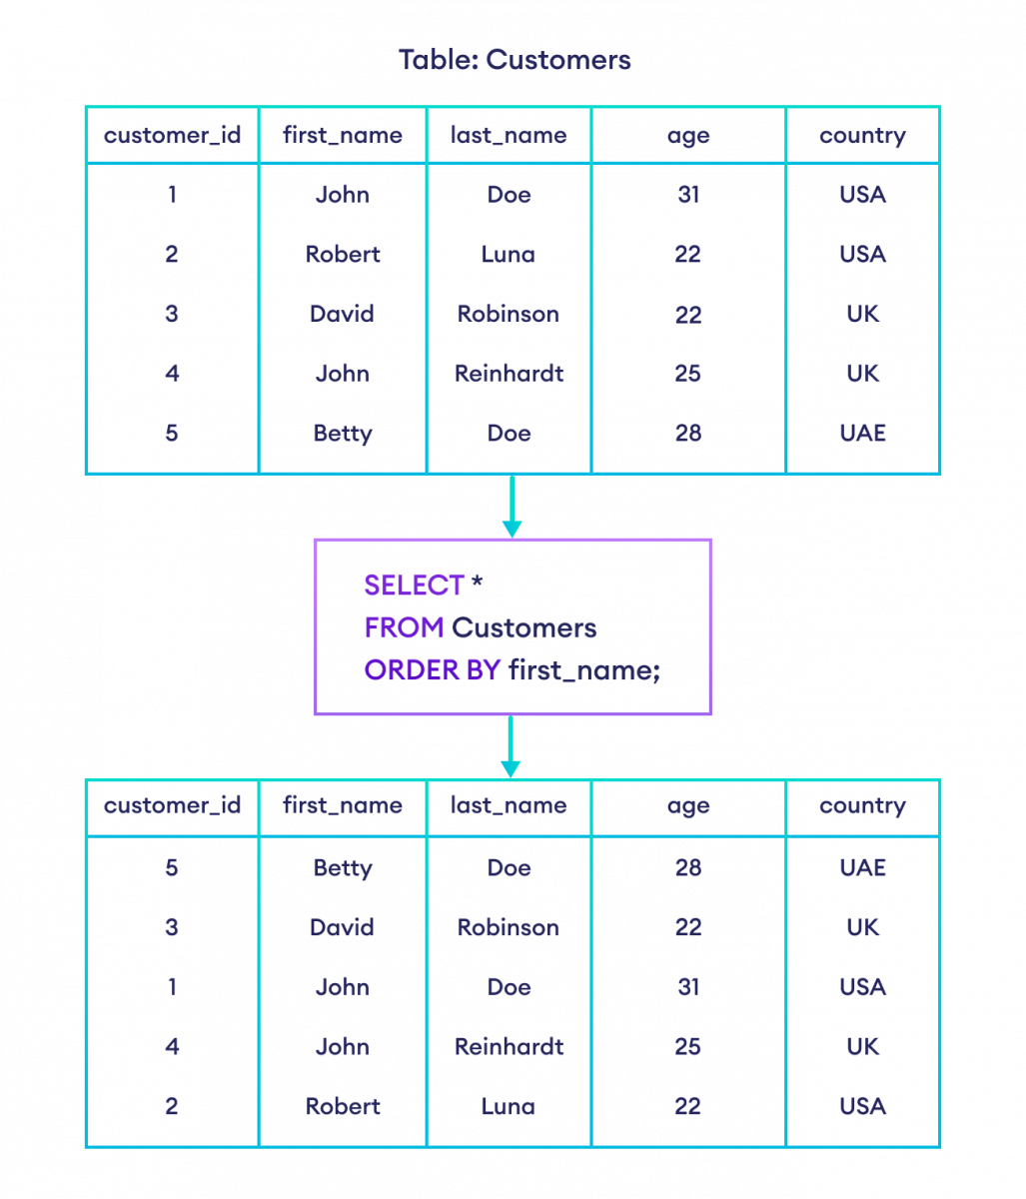

Slide 18
Group By
n
SQL, the GROUP BY clause is used to group rows by one or more columns.
Syntax:-
SELECT column1, column2, ...
FROM table
GROUP BY columnA, columnB, ...;
Example:-
select the item column and the count of order ids from the Orders table
-- group them by the item column
SELECT COUNT(order_id), item
FROM Orders
GROUP BY item;

Slide 19
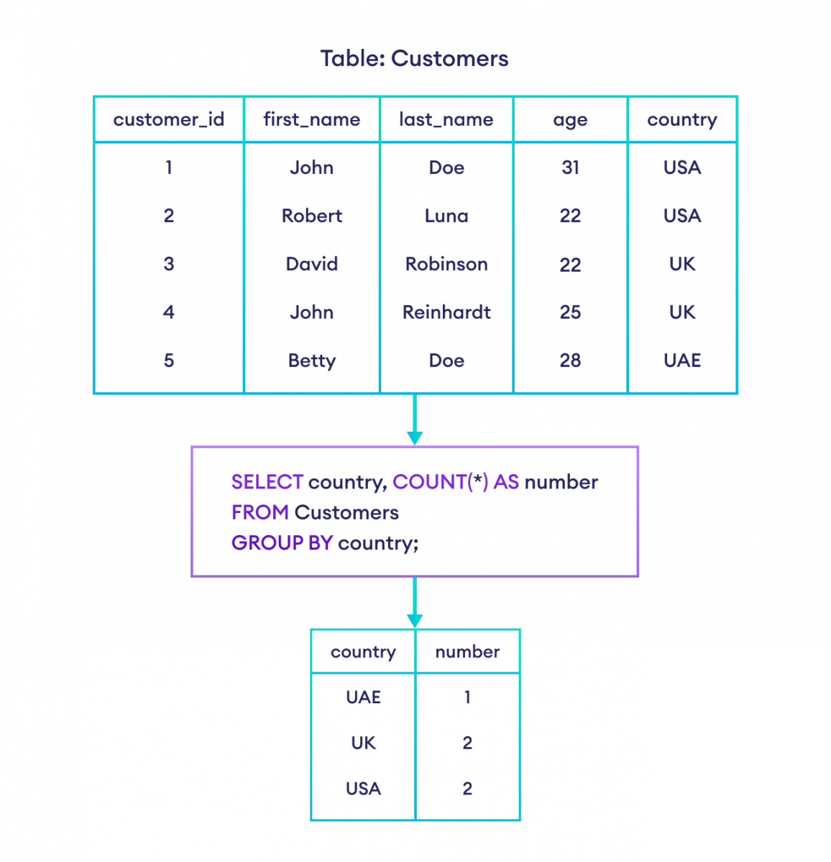

Slide 20
Having Clause
Syntax:-
SELECT AggFunc(column), extra_columns
FROM table
GROUP BY target_column
HAVING condition;
Explation Of Syntax:-
AggFunc(column) refers to any aggregate function applied to a column
extra_columns are other extra columns to filter
GROUP BY groups the data by target_column
HAVING condition compares the column to certain conditions that require filtering

Slide 21
Having Clause
Example:-
-- select the count of customer ids greater than one and their corresponding country
SELECT COUNT(customer_id), country
FROM Customers
GROUP BY country
HAVING COUNT(customer_id) > 1;

Slide 22
